Slide 1
Generative
Adversarial
Networks

Slide 2
What can GANs do?
Generate fake faces
“Style mixing” of faces

Slide 3
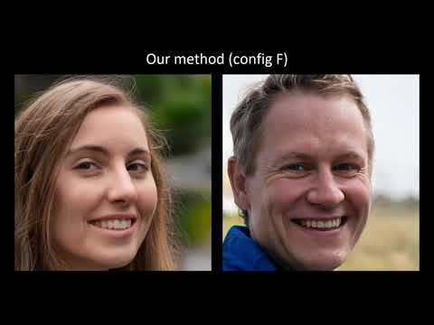
What can GANs do?
Generate fake faces
“Style mixing” of faces

Slide 4
What can GANs do?
Generate fake faces
“Style mixing” of faces

Slide 5
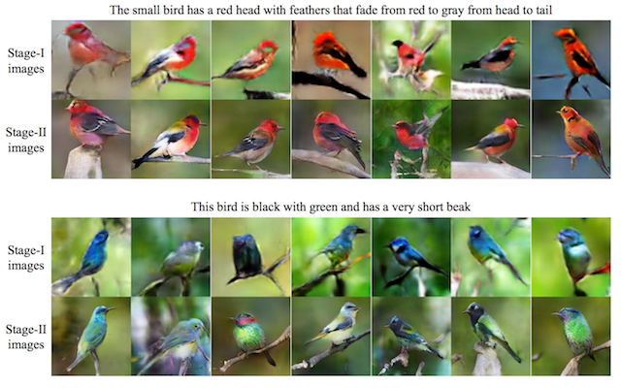
What can GANs do?
Generate fake faces
“Style mixing” of faces
Text to image translation

Slide 6
What can GANs do?
Generate fake faces
“Style mixing” of faces
Text to image translation
...and so on

Slide 7
How do they work?

Slide 8
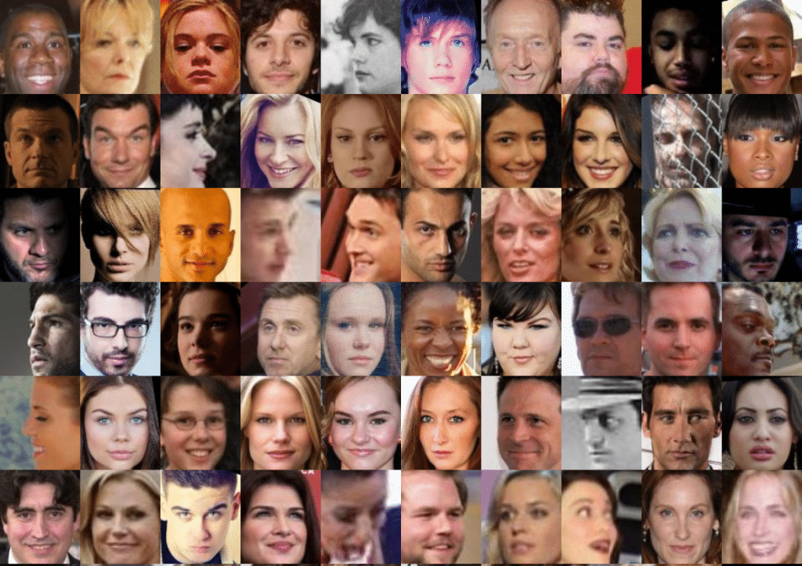
Begin with a dataset of real images.
(We want the generator to create similar works.)

Slide 9
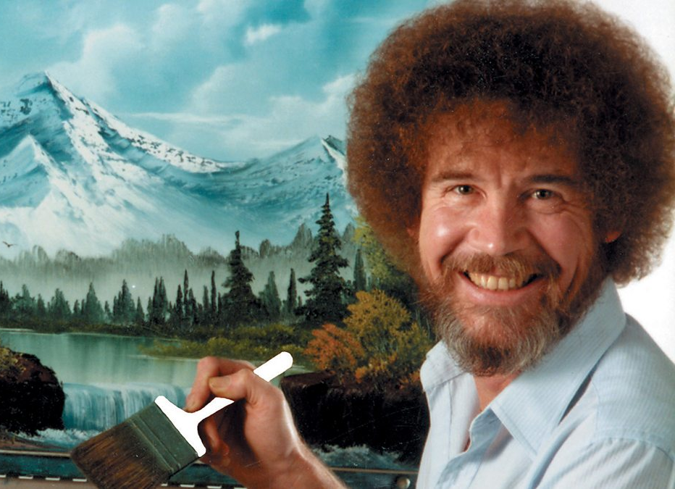
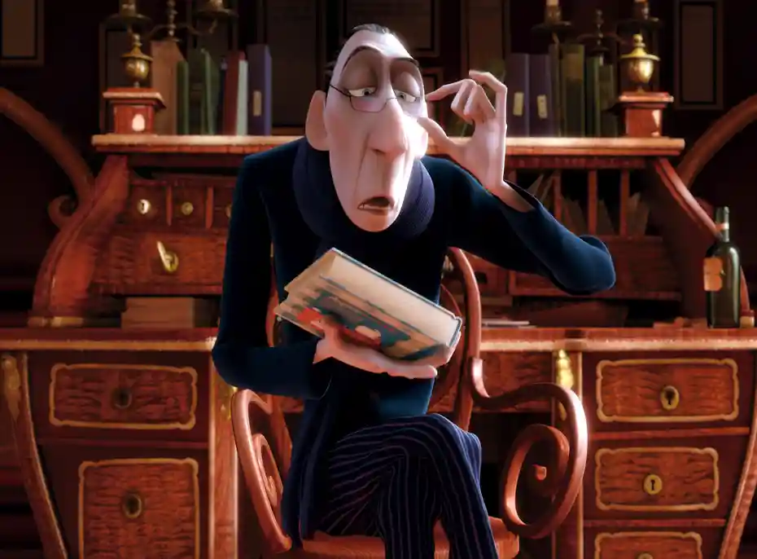
Generator
vs.
Discriminator
“The artist”
“The critic”

Slide 10
Discriminator’s job:
Identify real examples from the dataset vs. fake ones created by the generator.
Loss functions
Generator’s job:
Trick the discriminator into thinking generated examples are real.

Slide 11
Ultimately, we only care about the output from the generator.
But the discriminator is the one who forces the generator to get good.

Slide 12
What exactly happens at each step?

Slide 13
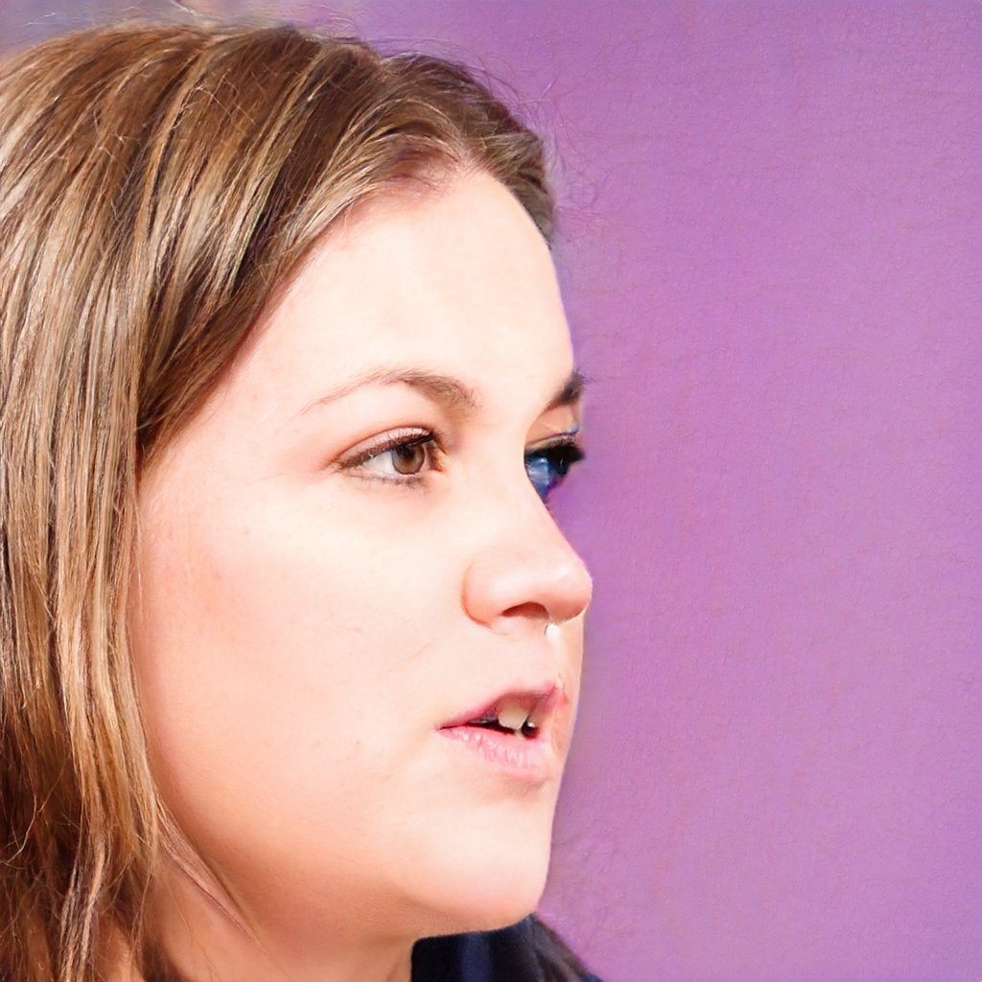


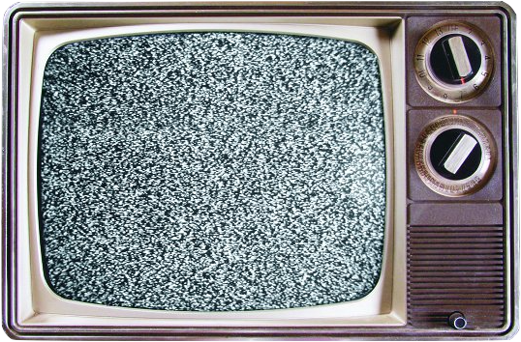

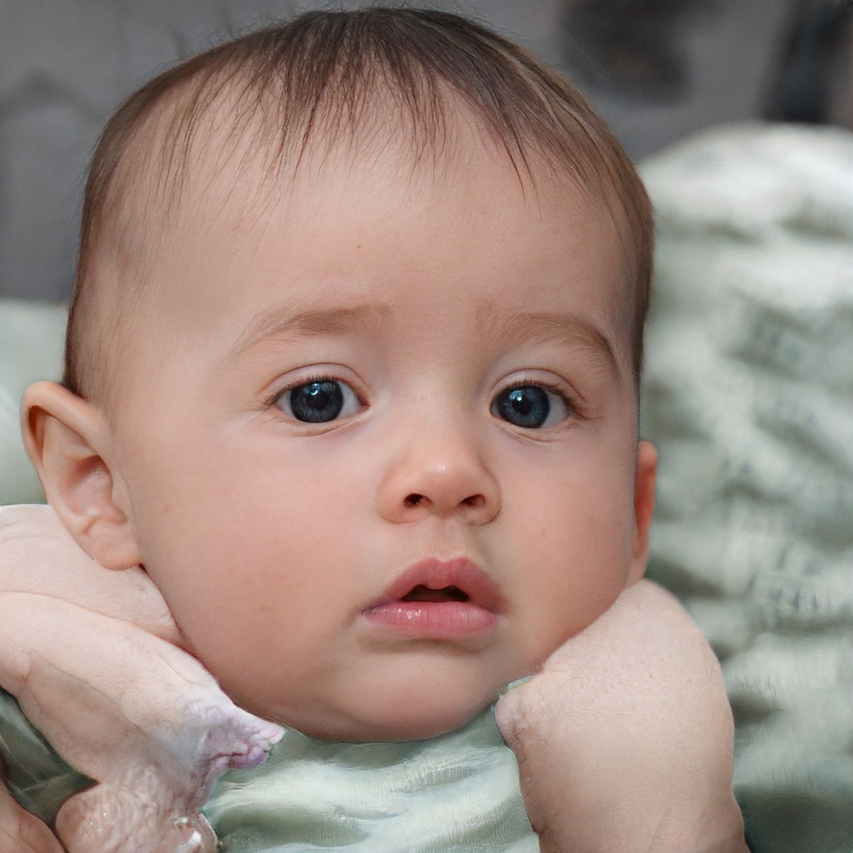
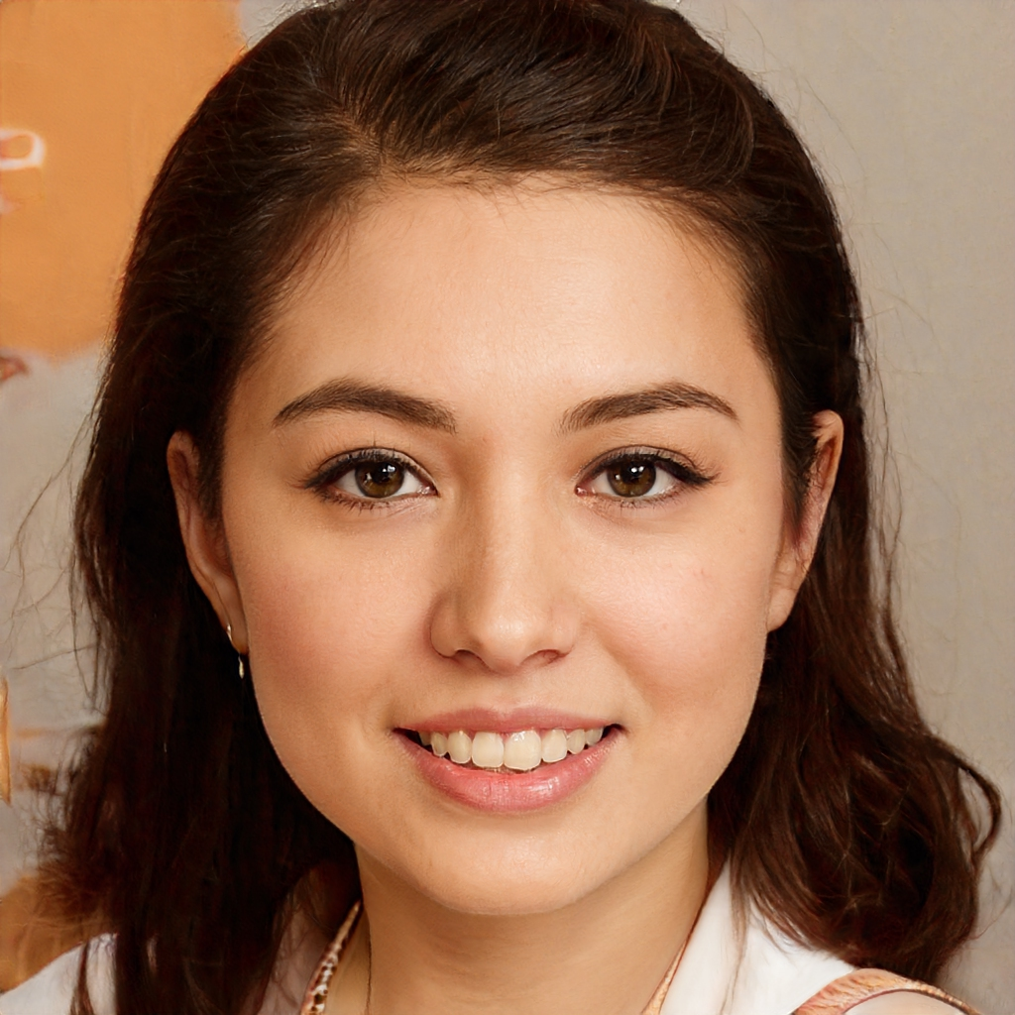

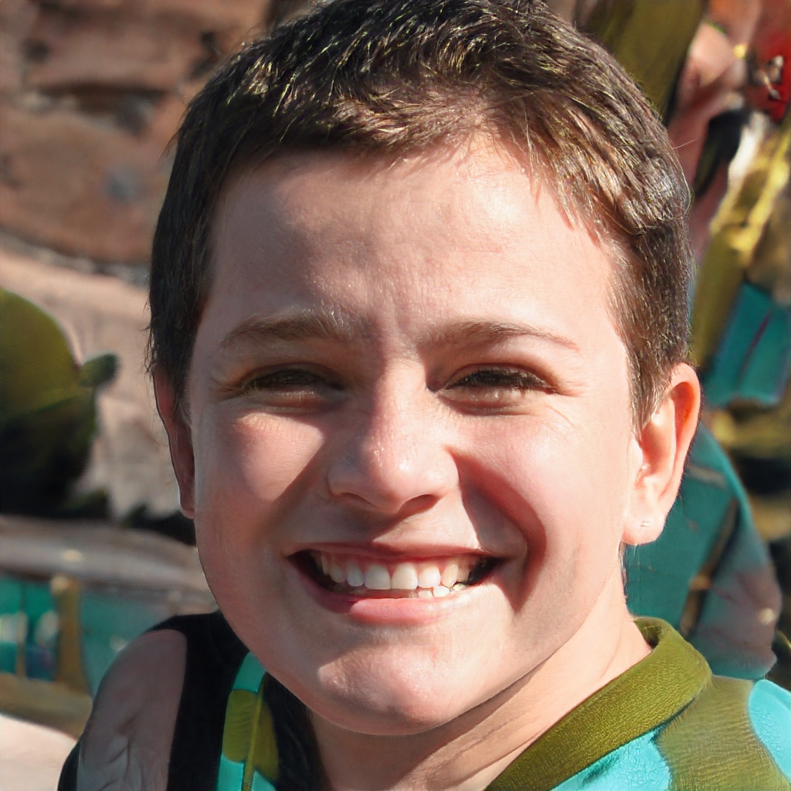





“Latent space” samples
Generator
Generated samples
Training examples
Real samples
Finally, the generator and discriminator each ask “What did I do wrong?” By analyzing their own performance, they become slightly less dumb.
Discriminator output
Backpropagation
Discriminator

Slide 14
What are we building today?

Slide 15
